Slide 1


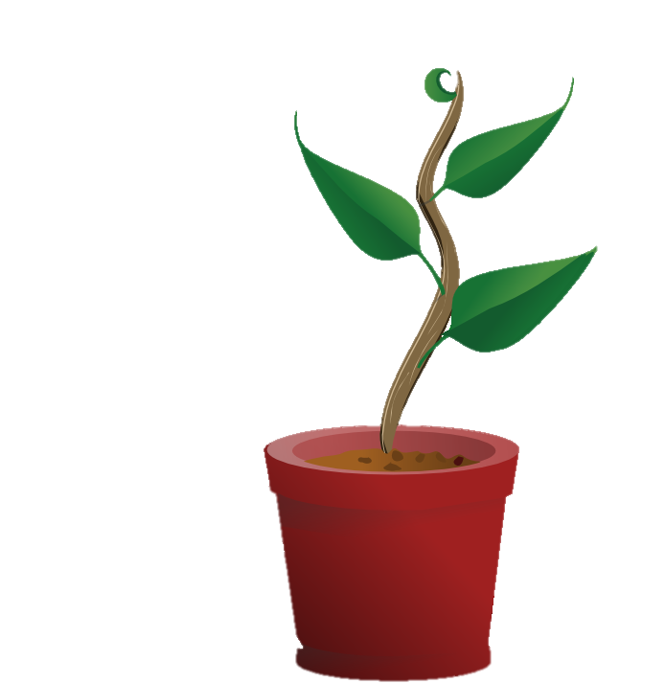
Our goal is to provide education and assistance for basic home plant-care.

Slide 2
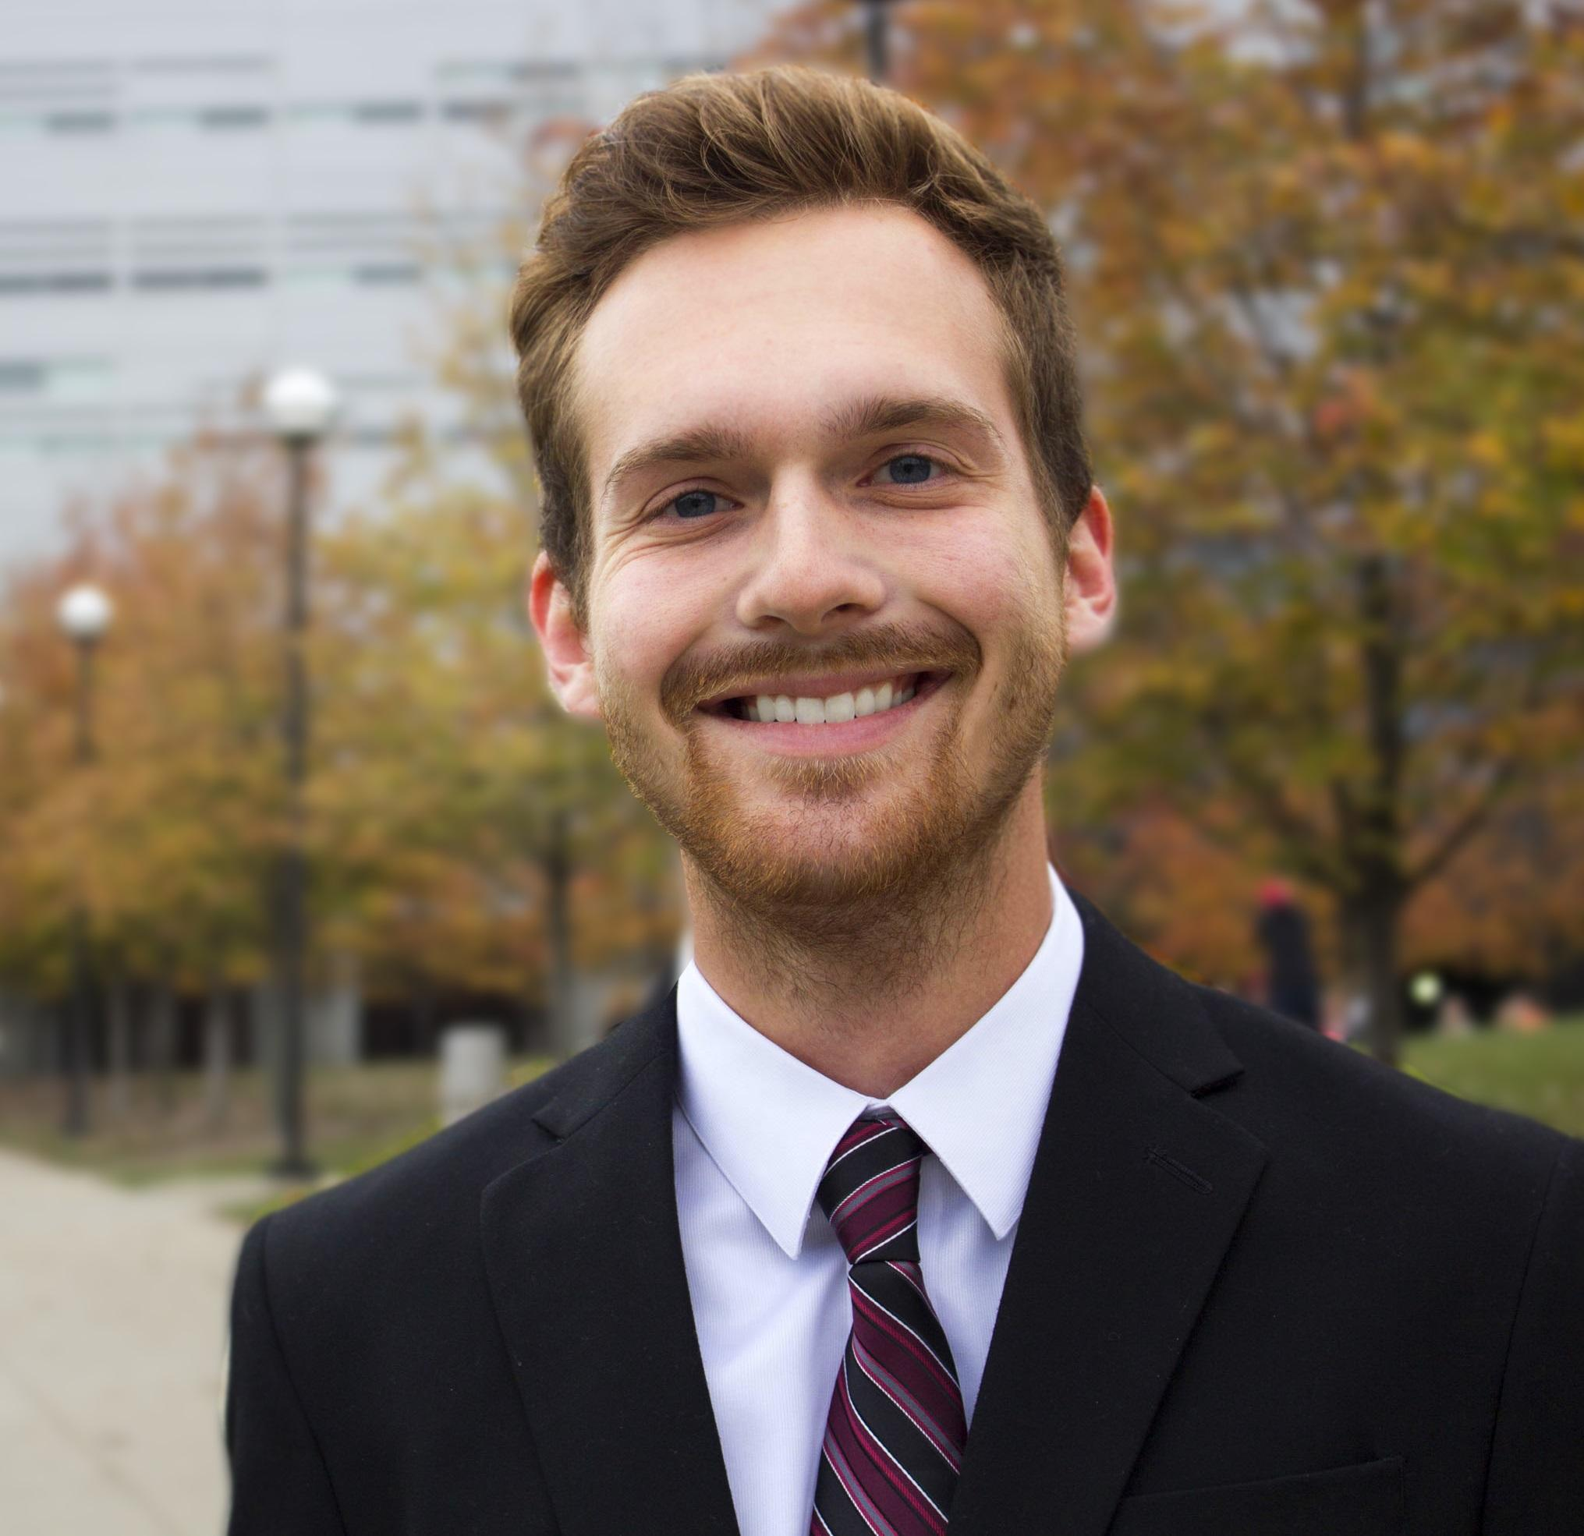
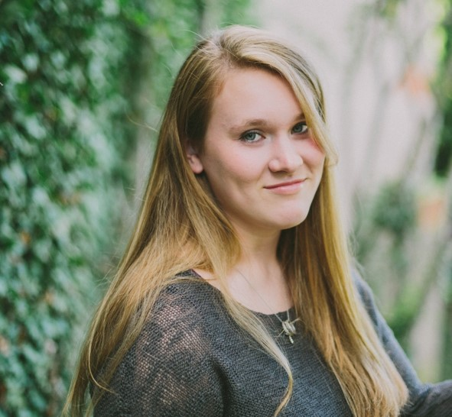
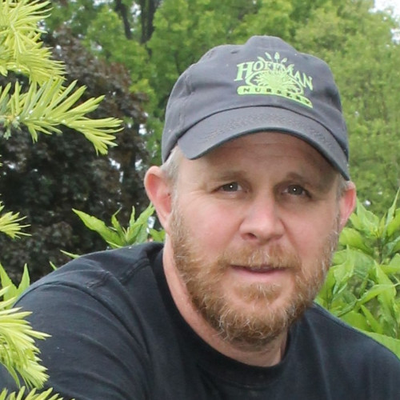
Plant Parenthood Team
Max Frisch
Rachael Chandler
Prof. James Hansel
Phone: (513) 706 – 2507
Email: frischmf@mail.uc.edu
Phone: (937) 789 – 7032
Email: chandlra@mail.uc.edu
Phone: (513) 203 – 7604
Email: hanselj@greatoaks.com

Slide 3
Project Abstract
Plants are a great way to brighten up any space and tend to provide many benefits for those who own them. However, plants are complex living things that require care and attention, often having needs that are specific to a certain plant type. It can be difficult for inexperienced plant owners to cultivate and maintain gardens or individual plants when they don’t know the needs of every type of plant they own. This is the problem that Plant Parenthood seeks to remedy.

Slide 4
Project Abstract.. 2
We’ve developed a solution using several new technologies to measure factors essential to plant health. By utilizing several sensors to measure soil moisture, atmospheric pressure, temperature, humidity, and light exposure we are able to provide valuable feedback to the user who is unsure of how to take care of their plant. To do this, we have attached a low-profile Raspberry Pi to a plant’s pot, and we have developed a service utilizing the gRPC protocol to communicate between our server, database, and Android client. Our application is developed in Python, Protobuf, C#, Microsoft SQL, and Kotlin respectively. Every ten minutes we are gathering current plant data and logging it in the database, so that the user can view historical data regarding the plant’s health.

Slide 5
Project Abstract.. 3
Additionally, every three hours the data gathered is then analyzed and compared to values in the database that establish healthy boundaries for different plant types to determine if they are in a healthy range. If the plant factors found are outside of this predetermined range, we notify the user of the issue and advise on how to best take care of the plant going forward. Our database includes information on several different types of common plants, so the user is free to branch out from the usual plants they have with confidence in their ability to care for their new addition.

Slide 6
Project Abstract.. 4
Plant Parenthood offers a simple solution to the average person that wants plants to be part of their life. However, it may have implications beyond an individual with house plants. Greenhouses are used to grow anything from aesthetic flowers to food sources to medicinal herbs. In such massive quantities it can be hard to monitor the health of each individual plant, or even a group of plants. By enlarging the scale and adding a few more Plant Parenthood hubs, Plant Parenthood could be used to monitor the health of many plants at once, keeping the tender aware of the status of all plants, resulting in more yield from the crop and less wasted time and resources.

Slide 7
Project Description
Plants can be difficult to take care of - they require consistent attention, different species need different care, and unless you are familiar with plants you may not know what it is that a plant needs to be healthy or what is lacking in the care you provide.
We seek to create a holistic solution to this problem, by creating an interactive system that supplements the caretaking process and provides helpful insight to improve the health of your plant.
We aim to monitor plant health and provide the plant-owner with relevant caretaking information. This will be accomplished using a Raspberry Pi to measure different metrics related to plant health (exposure to light, rhizosphere moisture level, pH, and relative humidity), and then will be analyzed to provide the user with helpful feedback regarding plant health and advice for future care.

Slide 8
User Stories
As someone new to plant-care, I want to receive in the moment notice of my plant’s needs so that I can learn how to care for it better.
As someone experienced with plant-care, I want to analyze in greater detail my plant’s environment so that I can implement more effective care and foster better growth.
As a botanist, I want to monitor the overall health of my greenhouse so that I can address issues with specific areas of my garden.

Slide 9
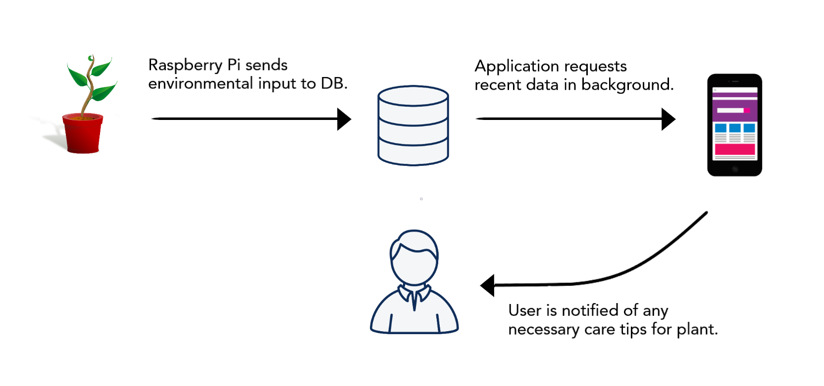
Design Diagram Level I

Slide 10
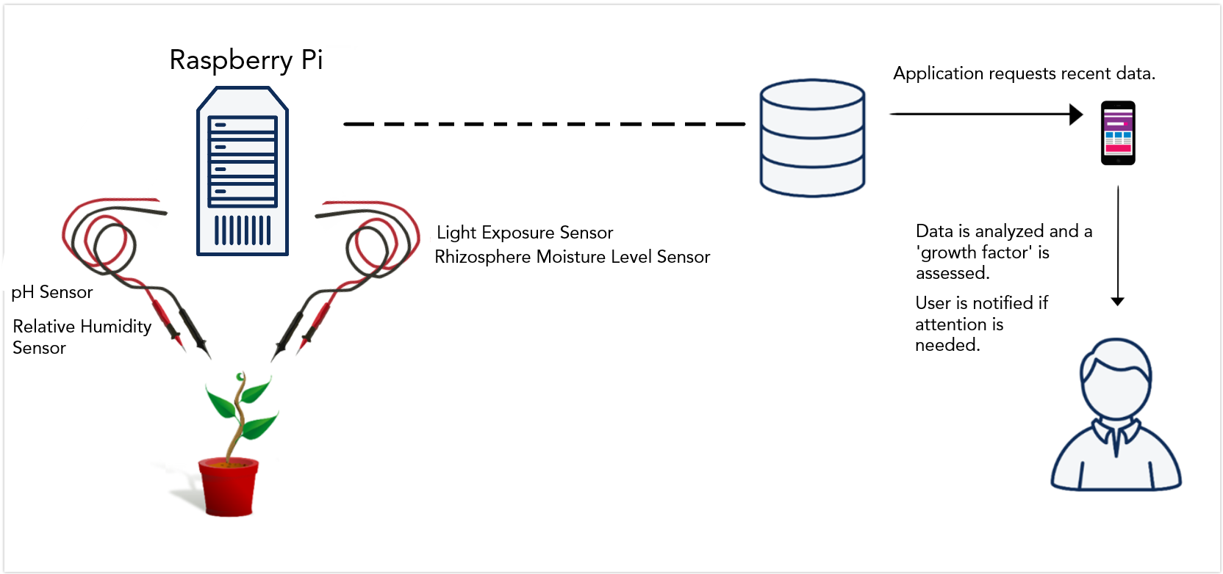
Design Diagram Level II

Slide 11
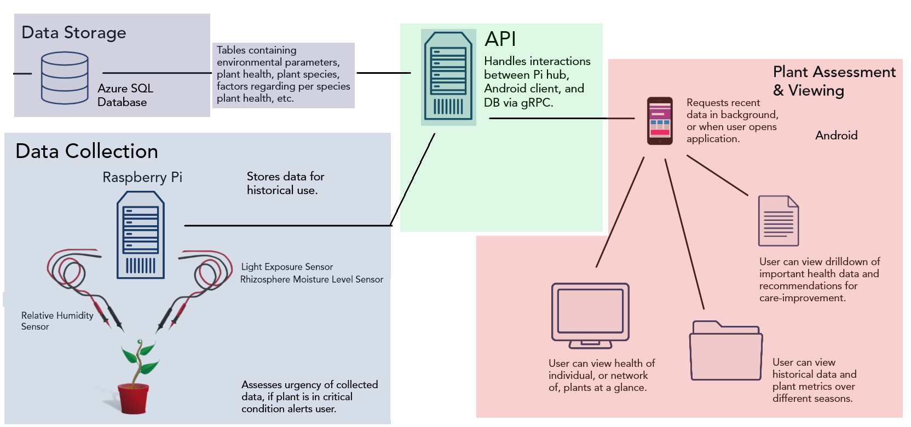
Design Diagram Level III

Slide 12
Project Constraints
Financial
Hardware costs
Raspberry Pi - ~$40
Soil moisture sensor - ~$10 - $15
Humidity sensor - ~$10
Light intensity sensor - ~$9
Soil pH detector: ~$10
Using free software
Testing supplies
Pots, plants, soil, etc.
~$40
Total Estimated Cost: $125
Professional
We know little about plant life and care
We have decided to work with a professor in the horticulture department to supplement our plant knowledge

Slide 13
Current State of Project
Project Complete
API written utilizing gRPC to handle interactions between clients, servers, and DB.
Android Client for monitoring plant health
Pi Hub collecting sensor data
Azure SQL Database storing historical data

Slide 14
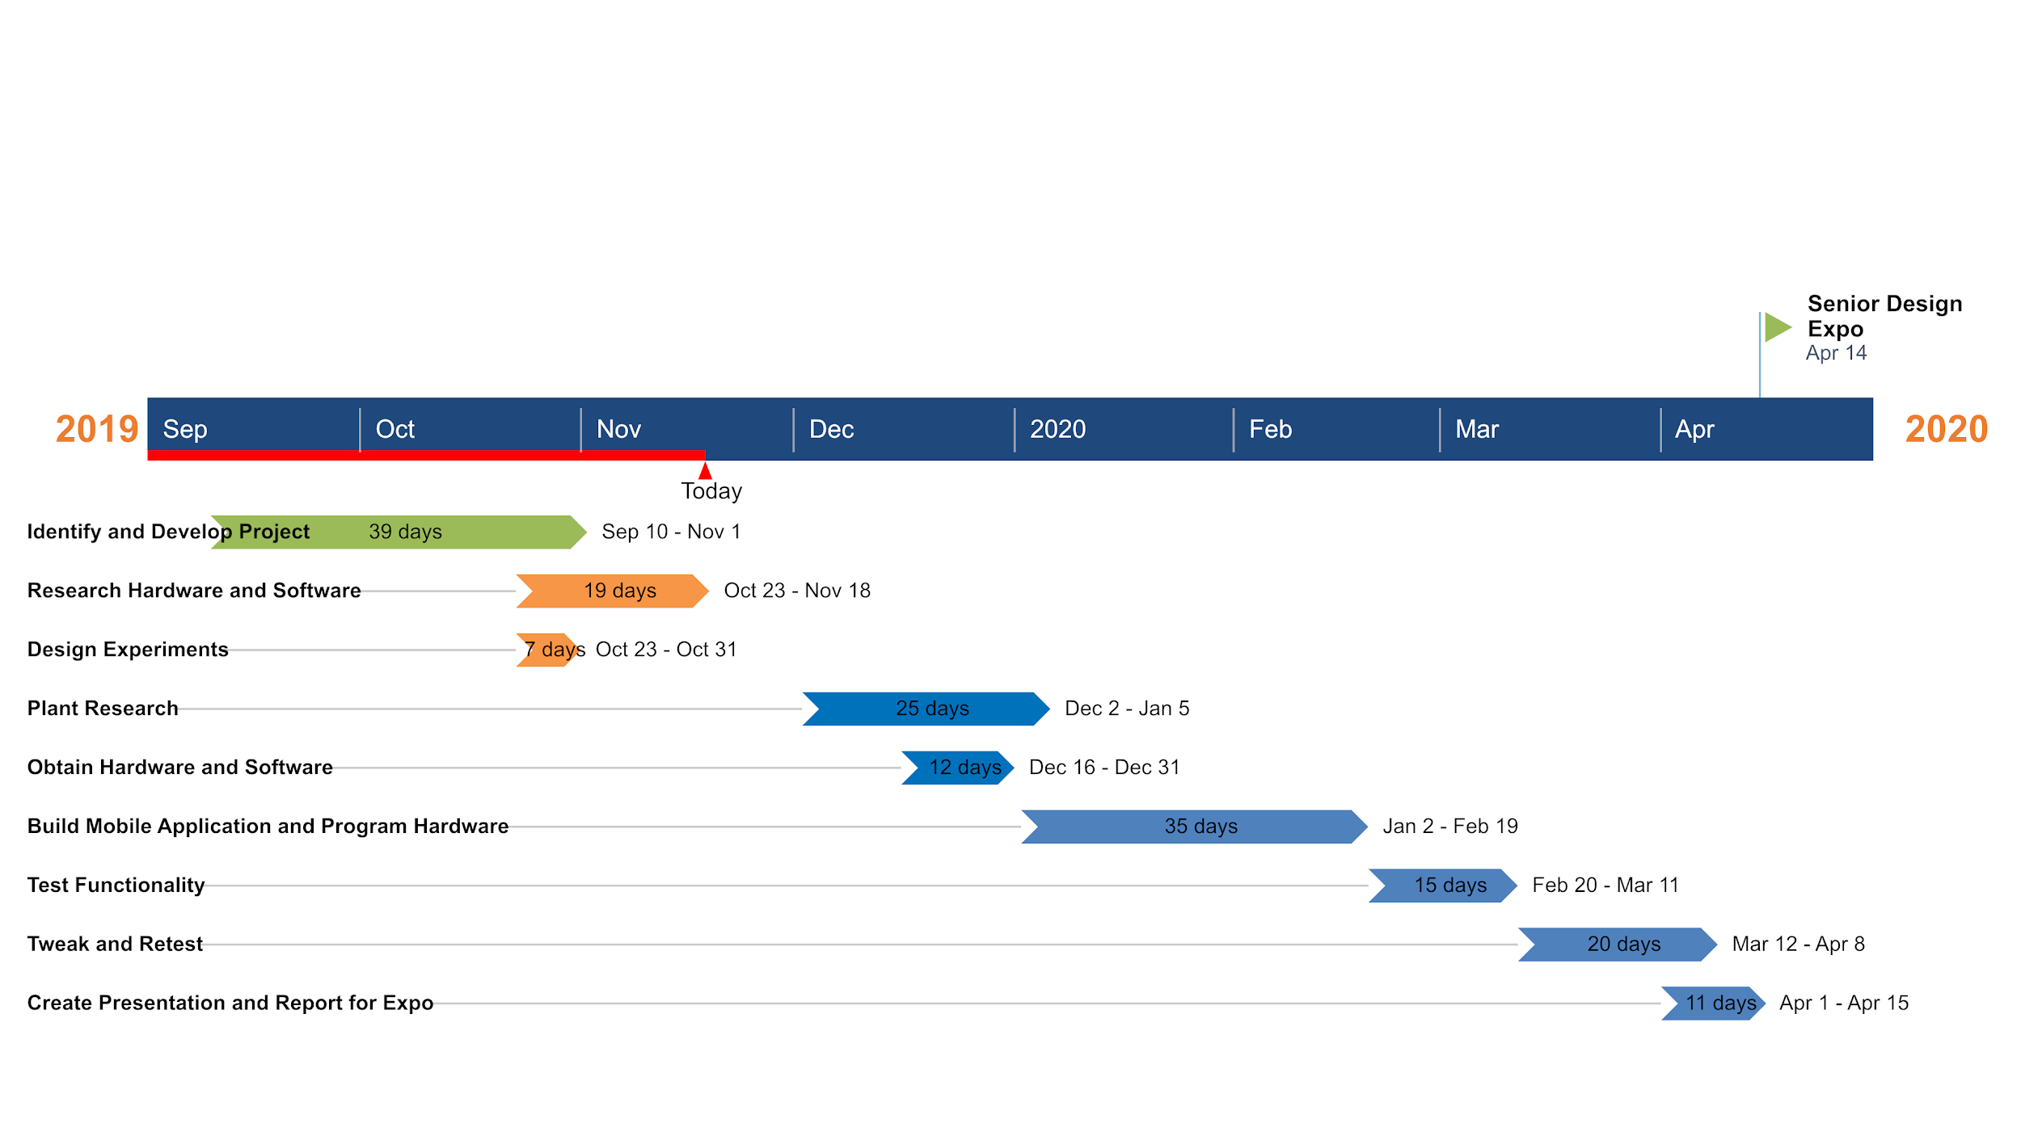
Project Timeline & Milestones

Slide 15
Demo
Display Board
Explanation of Project
Development process
Results from experiments/evaluation of the project
Prototype including soil, plant, and Android app
Demonstration of product

Slide 16
Any Questions?

